Slide 1




ARDUINO
BESTIN AUTOMATION

Slide 2
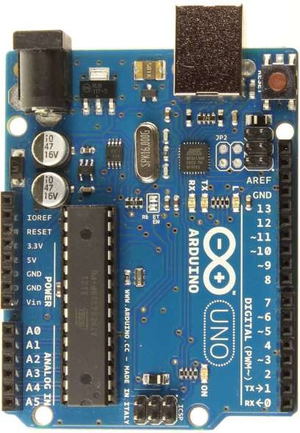
What is an Arduino ?
Open Source electronic prototyping platform based on flexible easy to use hardware and software.

Slide 3
Arduino
Arduino is an open-source electronics prototyping platform based on flexible, easy-to-use hardware and software.
Founded by Massimo Banzi and David Cuartielles in 2005.
An open-source hardware platform based on Atmel AVR microcontroller and a C++ based IDE.
In-Expensive, Simple and easy to learn programing.
Controller independent programming language.
One language compatibility with all boards.
Single software for programming, compiling and burning the code.

Slide 4
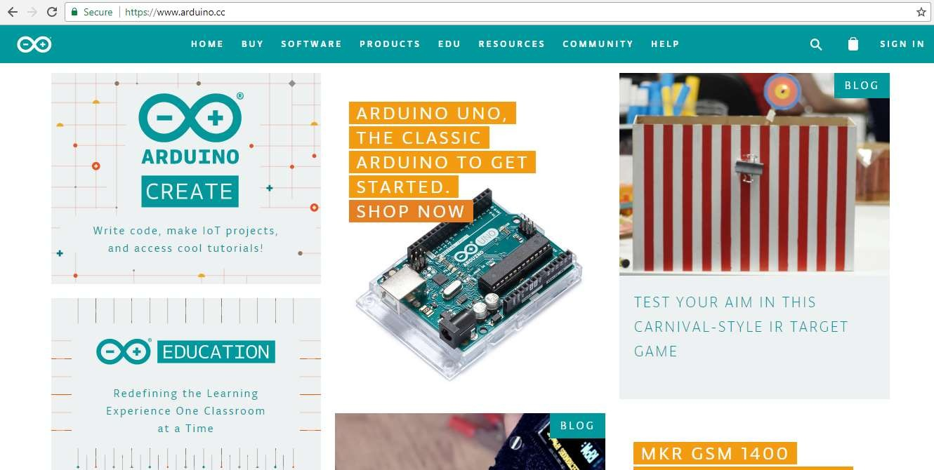

Slide 5
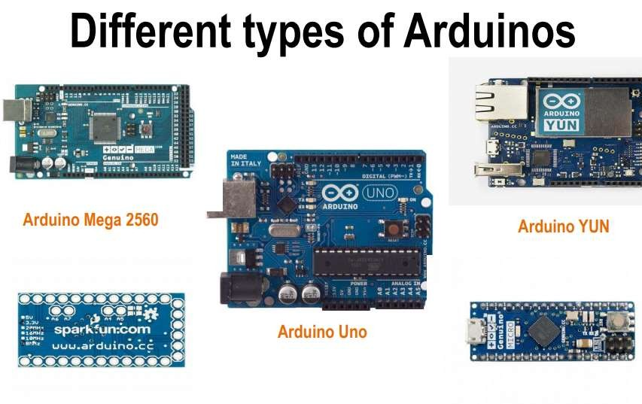

Slide 6
http://www.arduino.cc/
Arduino is an open-source electronics prototyping platform based on flexible, easy-to-use hardware and software. It’s intended for artists, designers, hobbyists, and anyone interested in creating interactive objects or environments.
Processor: 16 Mhz ATmega328
Flash memory: 32 KB
Ram: 2kb
Operating Voltage: 5V
Input Voltage: 7-12 V
Number of analog inputs: 6
Number of digital I/O: 14 (6 of them PWM)

Slide 7
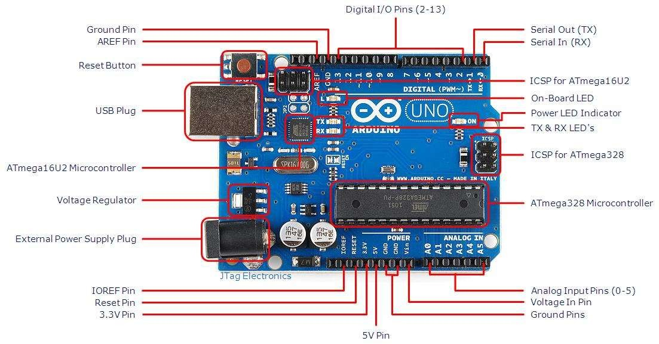

Slide 8
Getting Started
Check out: http://arduino.cc/en/Guide/HomePage
Download & install the Arduino environment (IDE)
Connect the board to your computer via the USB cable. If needed, install the drivers
Launch the Arduino IDE
Select your board
Select your serial port
Open the blink example
Upload the program

Slide 9
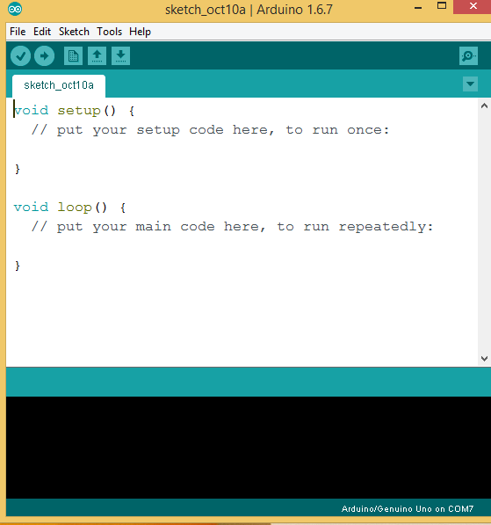
Arduino IDE
Menu Bar
Button Bar
Actual Code
Status Bar
Program Notification Area

Slide 10
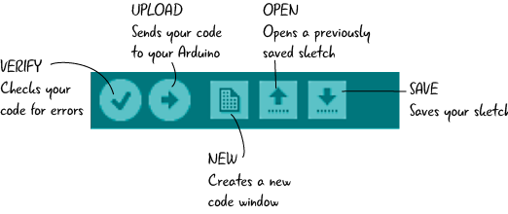
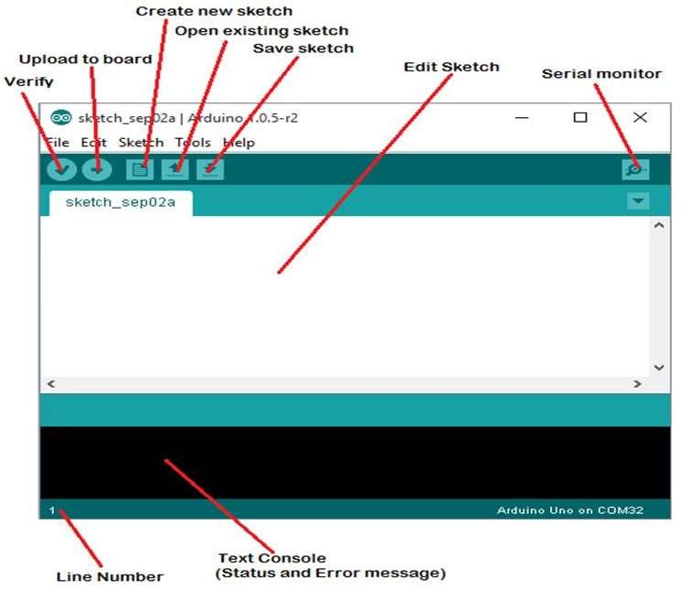

Slide 11
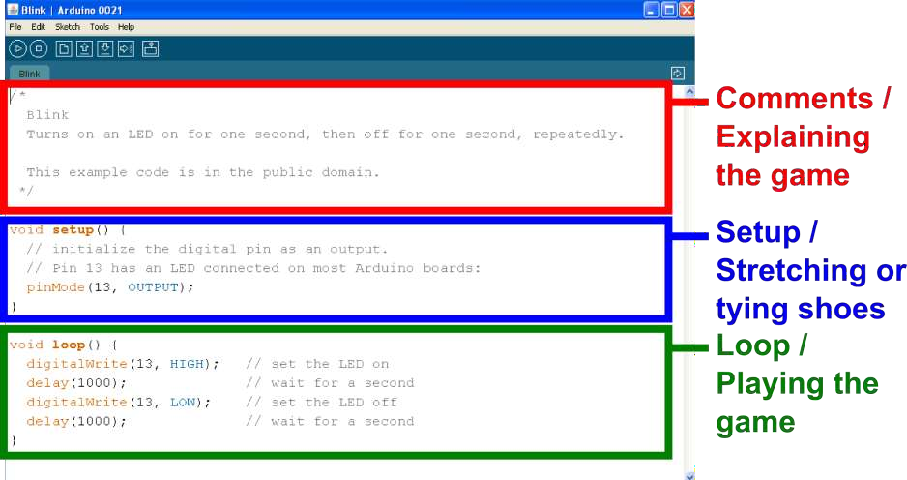
Parts of the Sketch

Slide 12
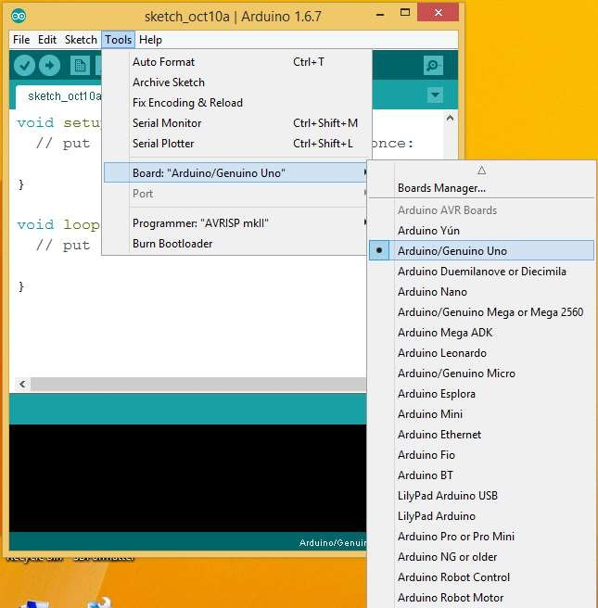
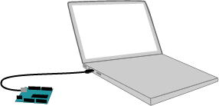
Select Board

Slide 13

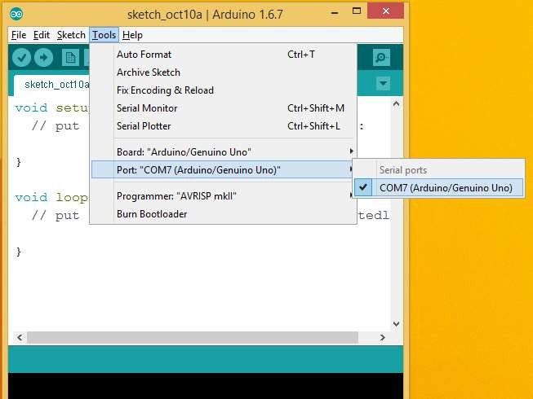
Select com port

Slide 14
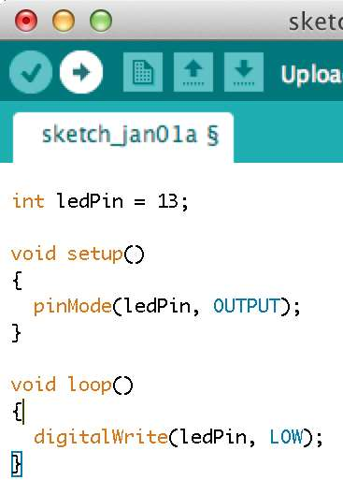
First program
int ledPin = 13; void setup()
{
pinMode(ledPin, OUTPUT);
}
void loop()
{
digitalWrite(ledPin, HIGH); delay(2000); digitalWrite(ledPin, LOW); delay(2000);
}

Slide 15
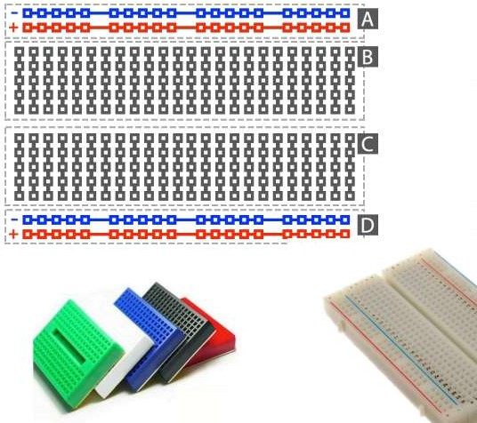
Bread Board

Slide 16

Happy Coding
Journey begins from here……

